Slide 1
Cars
By: Sean and Oswal

Slide 2

Our dataset got deleted

Slide 3
Audience
The class to show how removing different features changed
how even different types of linear regression can get different results
how even a simple linear regression can be better than a more complex neural network
chinese car makers coming into American market (is what the dataset is for if you get models working)

Slide 4
Linear Models
Linear Regression good for:
small data size (ours is about 205 which is pretty small)
It should mostly be linear
No Regularization
RidgeCV
L2 (Ridge) Regularization
Built-in Cross-Validation
Helps prevent overfitting
Alphas parameter: Regularization strength

Slide 5
Linear Models
Elastic Net
Uses L1 (Lasso) and L2 (Ridge) Regularization
Alpha parameter: multiplies the penalty terms
L1_ratio parameter: L1 if ratio = 0, L2 if ratio = 1, 0 < ratio < 1 is a combination of L1 and L2
ARD Regression
A Bayesian (Automatic Relevance Determination) Regressor
SGD Regression
Could use L1 and L2 Regularization

Slide 6
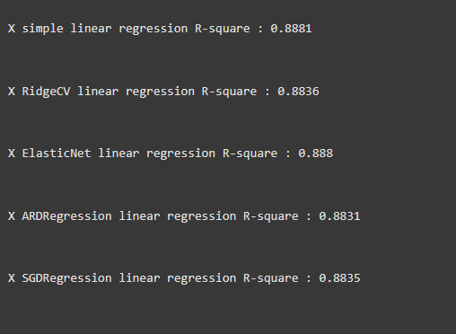
Linear Models Results

Slide 7
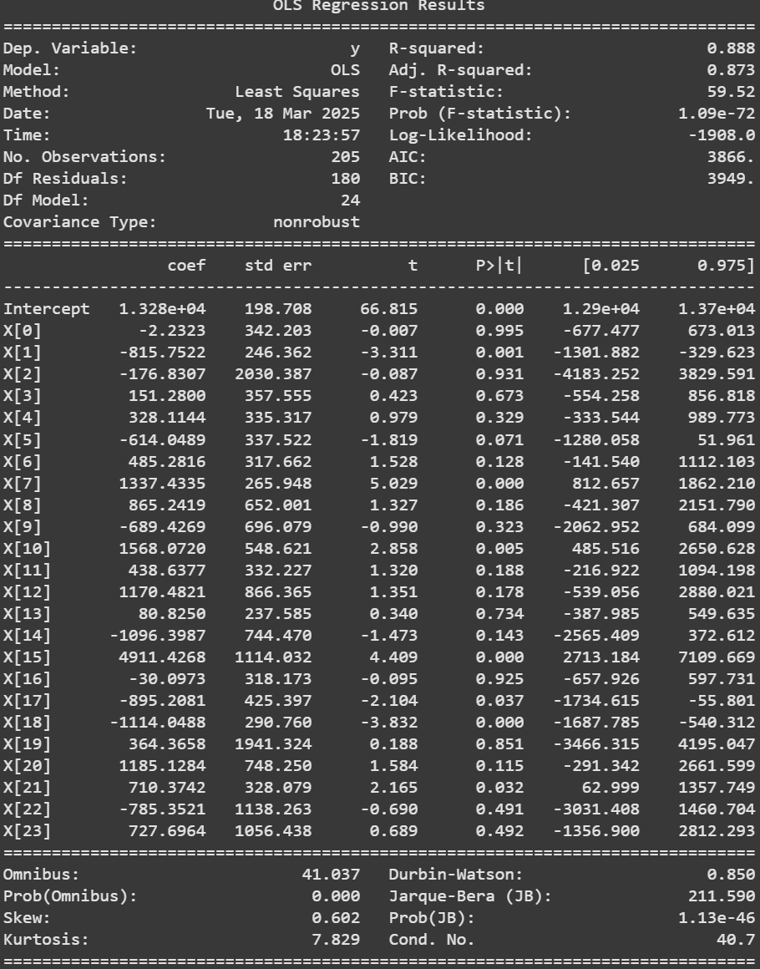
Parameter Checking
Trying to find if which parameters lead to a better R²
removed ones that had zero between
negative t
small t (t values smaller than or very close to 1)
p bigger than 0.5
p bigger than 0.3
p bigger than 0.1
p bigger than 0.05
p smaller than 0.5
to show a point

Slide 8
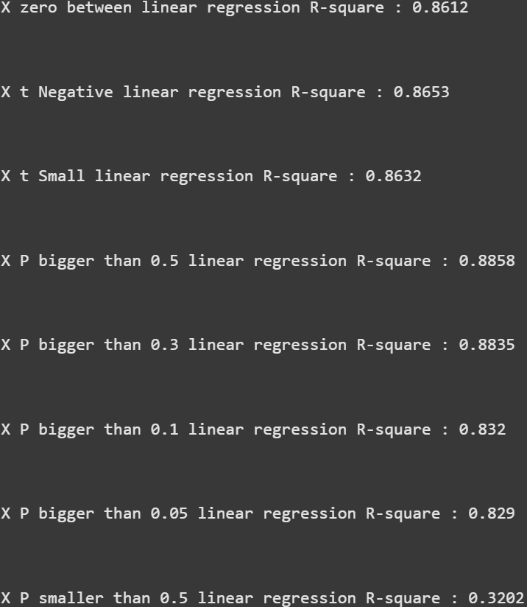
Parameter R ²
These are made with simple linear regression regression models so we want to get a R² bigger than 0.8881
None of them gets better than 0.8881 but P bigger than 0.5 and P bigger than 0.3 got fairly close. (we will use those for testing)
P smaller than 0.5 makes sense that it will be quite worse since by excluding the P values smaller than 0.5 we should only really be getting the features that aren’t too good

Slide 9
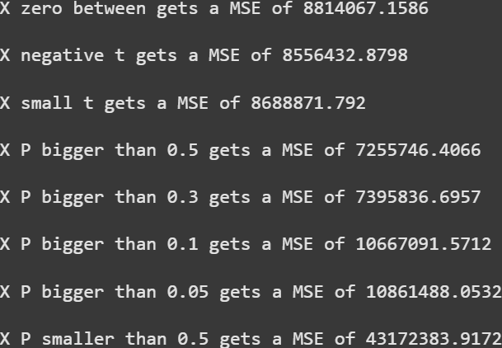
Parameter MSE
We see that R² closer to 1 get a lower MSE.
We can see that the MSE for P bigger than 0.5 and P bigger than 0.3 give us the best results while P smaller than 0.5 gets the worst results.

Slide 10
Comparisons
Now we will compare several different regression models and how how they compare to each other.
We will use all 3 different sets of features that we believe will have the best results.
All the features
Remove features with a P bigger than 0.5
Remove features with a P bigger than 0.3
(this will be tested later as well)

Slide 11
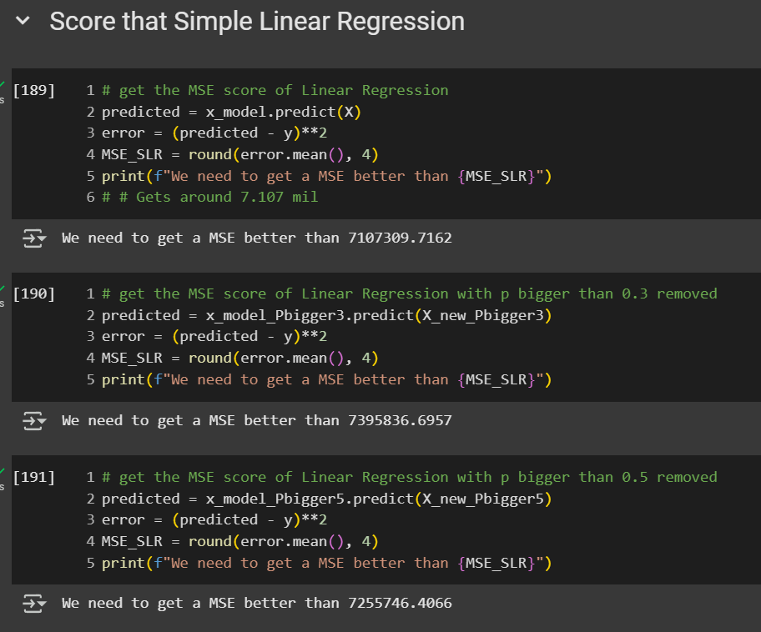
Simple Linear Regression
We see that Simple Linear Regression with all the features gets a better MSE with a score of 7.103 million

Slide 12
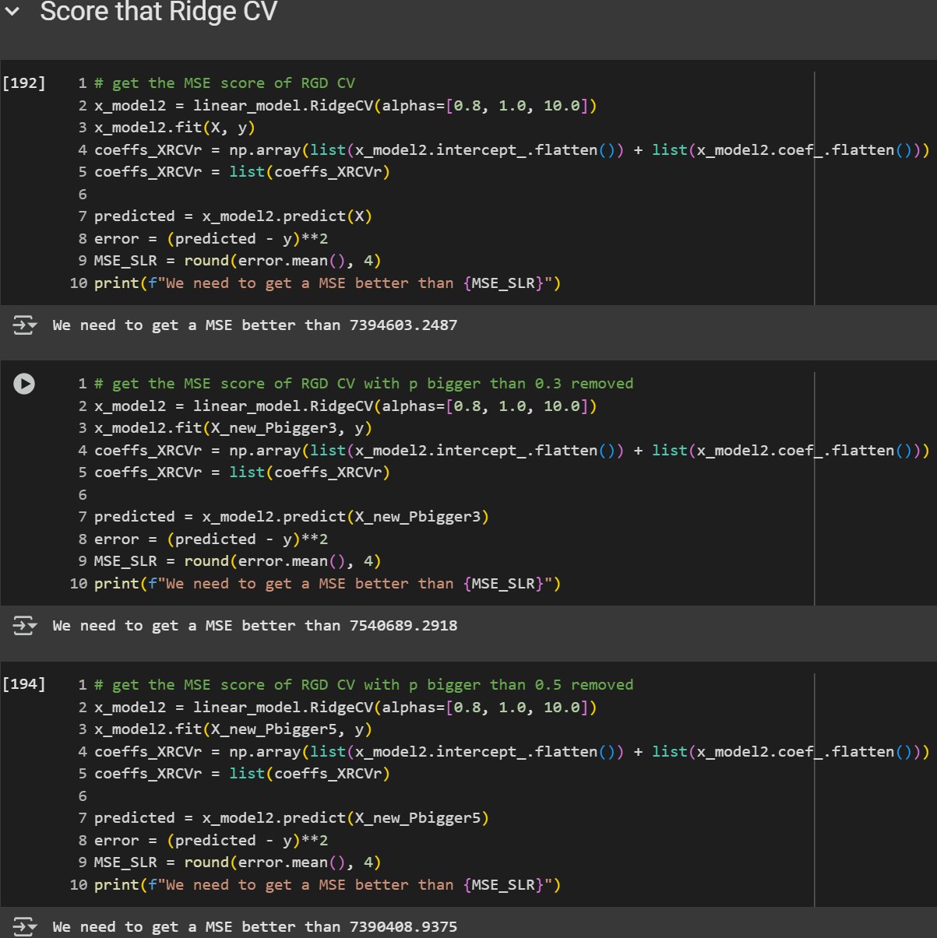
Ridge cv
We see that Ridge CV with P bigger than 0.5 gets a better MSE
This time, the MSE of all the models increased from the Simple Linear Regression which would make Simple Linear Regression so far.

Slide 13
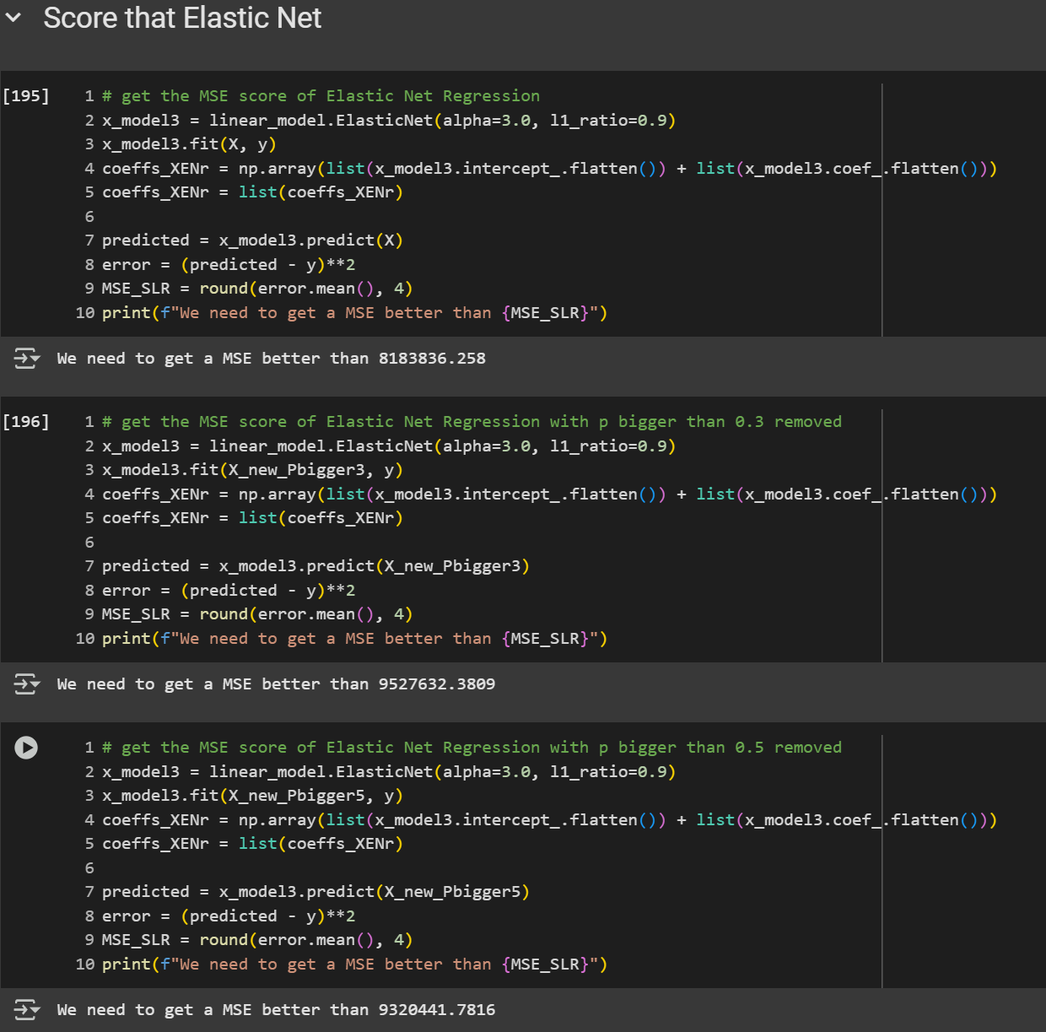
Elastic Net
We see that Elastic Net with all the features gets a better MSE
Again, the MSE score increased again to have the smallest MSE score now be around 8.184 million

Slide 14
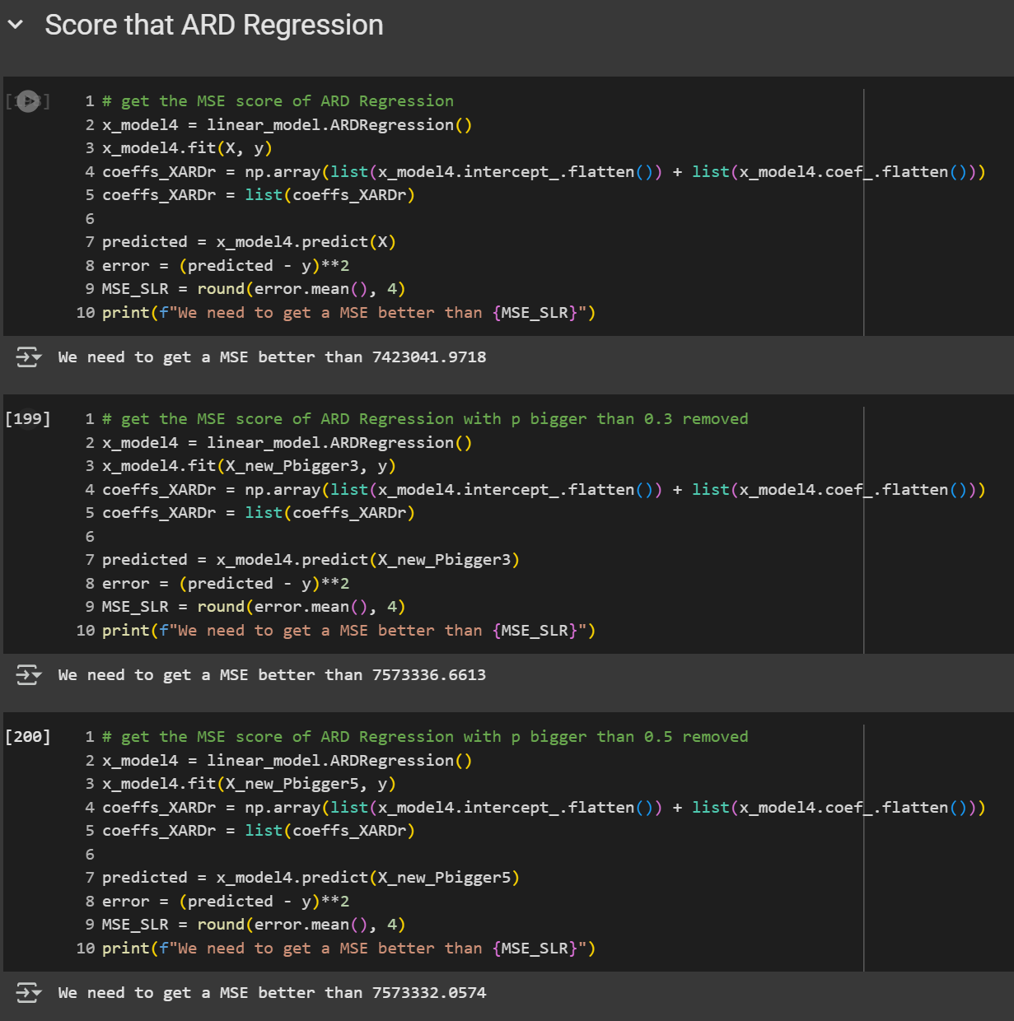
ARD Regression
We see that ARD Regression with all the features gets a better MSE
It seems to get similar results to the Ridge CV but still worse results compared to a simple linear regression

Slide 15
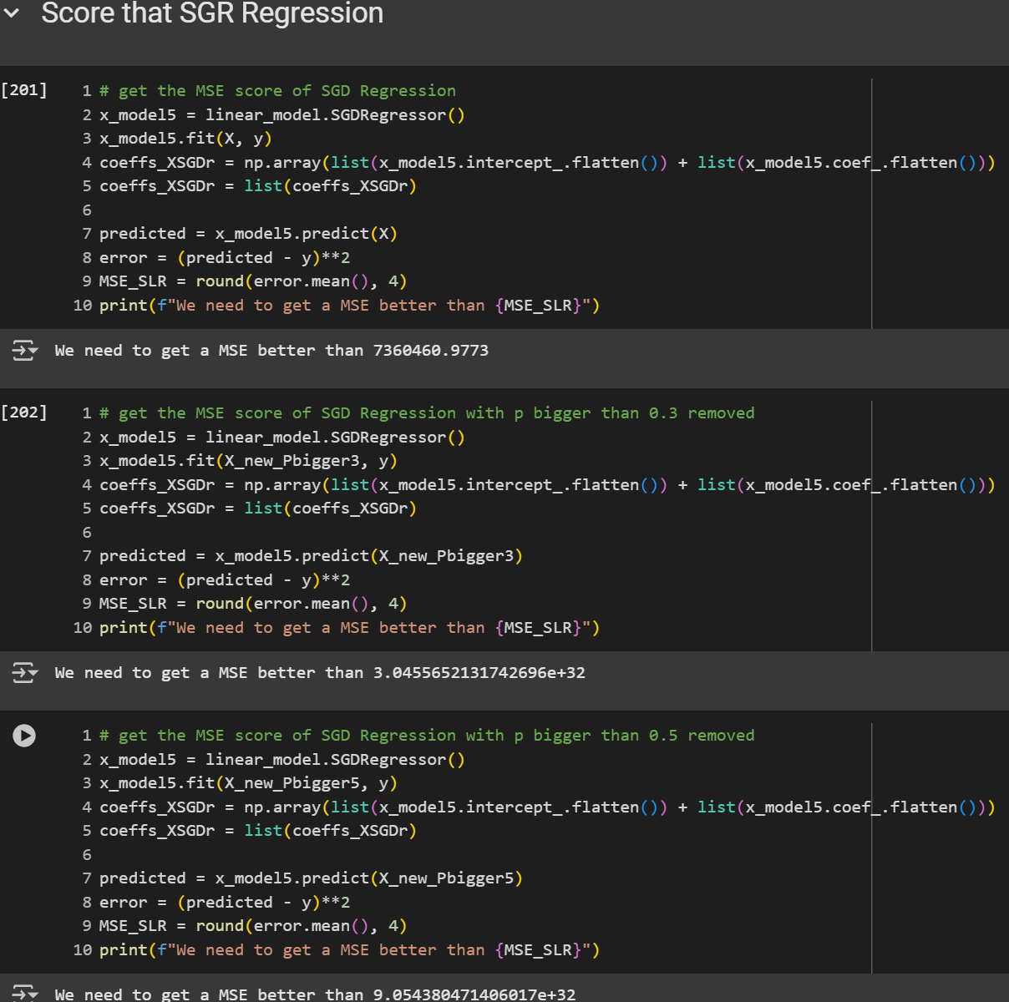
SGD Regression
We see that SGD Regression with all the features gets a better MSE
While the other explode and get a massive MSE which is not good

Slide 16
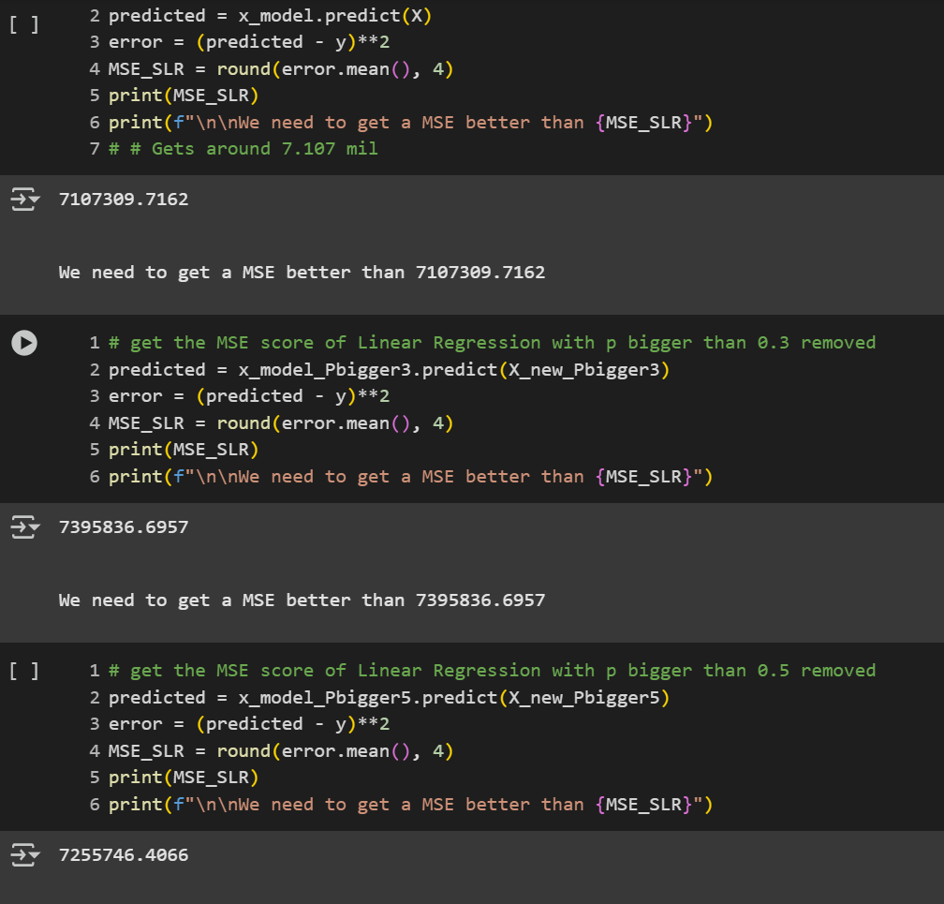
Linear Regression Again
The one with all the features gets MSE of 7.107 million
The one with the P bigger than 0.3 removed gets MSE of 7.396million
The one with the P bigger than 0.5 removed gets MSE of 7.256million

Slide 17
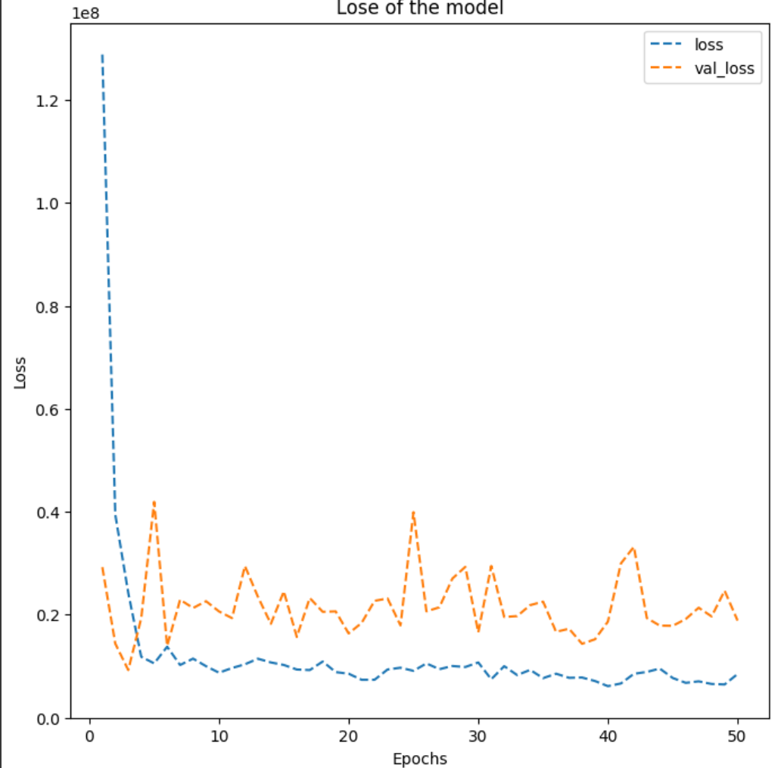
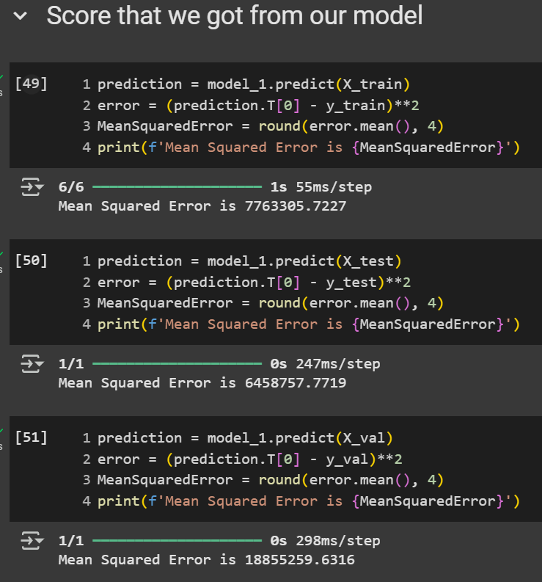
Our model results
We would sometimes get a one of them to be smaller than the linear regression model (in this case X_test) and one or two that are really bad (in this case just X_val).
We typically get one or two that is close but most of the time above the linear regression model (like with the X_train)

Slide 18
Our model
Not as good as linear regression
Results never seems to be better then linear regression and seem to overfit with no apparent way to really make it reliable

Slide 19


